Slide 1
Machine Learning Final Project
55908 - Machine Learning
Tal Karaev & Doron Firman

Slide 2

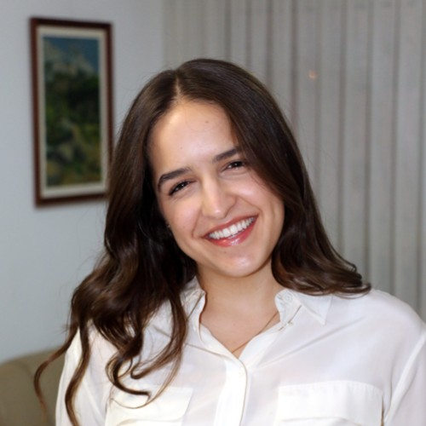
The Team
Doron Firman
Tal Karaev

Slide 3
Business Problem
Can insurance companies use data to increase their profitability?
Notes:
The U.S. insurance industry is one of the largest in the world
Natural accidents (like fires) are one of the major segments in the field
Insurtech is transforming the market - using tools like big data, artificial intelligence, and blockchain technology
In 2022, the total revenue of the U.S. insurance market was almost six trillion U.S. dollars.
Insurance fraud in the U.S. estimate costs reaches around $308.6 billion annually. Property and casualty fraud within it is around $45 billion.

Slide 4
The Datasets
We used three data sets:
National fire program analysis system data - The main data set consisting of the majority of the fire information
Climate data - A data set consisting of temperature and precipitation information for every month
fips - A data set that contains the fips code translation for each state

Slide 5
The Datasets
The following are the main features from the complete data set:
FIRE_YEAR - The year the fire occurred
STAT_CAUSE_DESCR - The cause of the fire
FIRE_SIZE_CLASS - The class of the fire (A is the smallest, G is the largest)
STATE - The state in which the location occurred
DURATION_IN_DAYS - How many days the fire went on
HighTempMonth - The highest temperature seen in the respective month
LowTempMonth - The lowest temperature seen in the respective month
PrecMonth - The average precipitation seen in the respective month

Slide 6
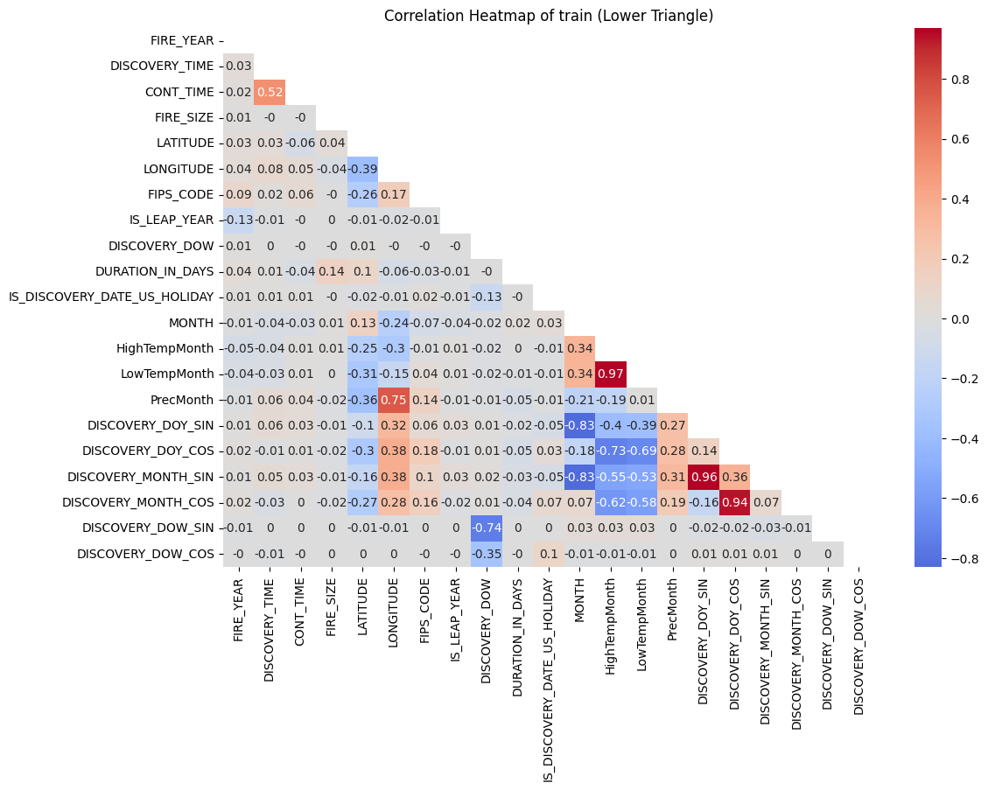
Exploratory Data Analysis
As we can see in most of the matrix we don’t have much correlation between variables
We can see that we have higher correlation between features that describe time in different manners
We also see a strong correlation between temperature features and to time features
Notes:
We started by checking the correlation matrix for the numerical features of the complete data set, and we got the following insights:

Slide 7
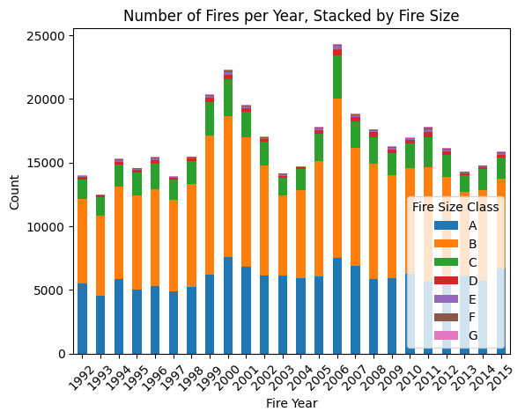
Frequency Analysis
On average there are 10k fires each year
Most of the fires are class B category fires
Fire sizes of class F, G are very rare (as expected)
Notes:
For this graph we wanted to see the number of fires per year and see what is the size distribution in each year

Slide 8
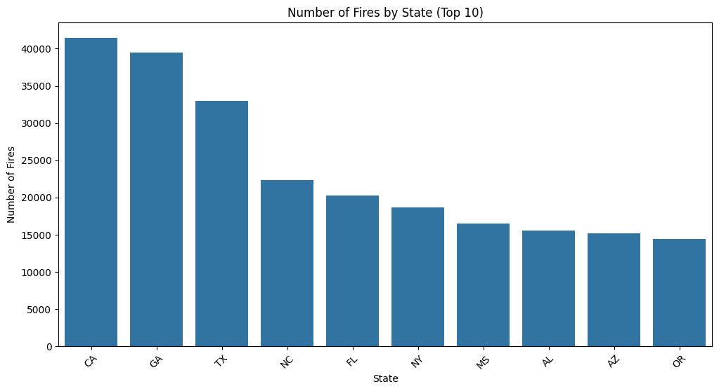
Frequency Analysis
We can see that CA has the most fires historically
We can see that there is a big difference between the first three states and the rest
Notes:
For this graph we wanted to see the amount of fires by state

Slide 9
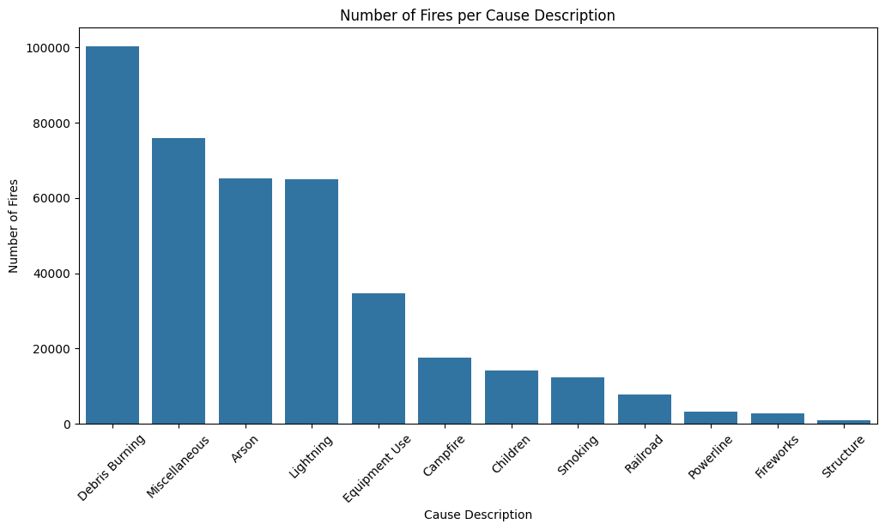
Frequency Analysis
We can see that debris are most common
We can see that there is a big difference between the first four causes and the rest
Structure issues seems to be a very rare fire cause
Notes:
For this graph we wanted to see what are the causes for fires

Slide 10
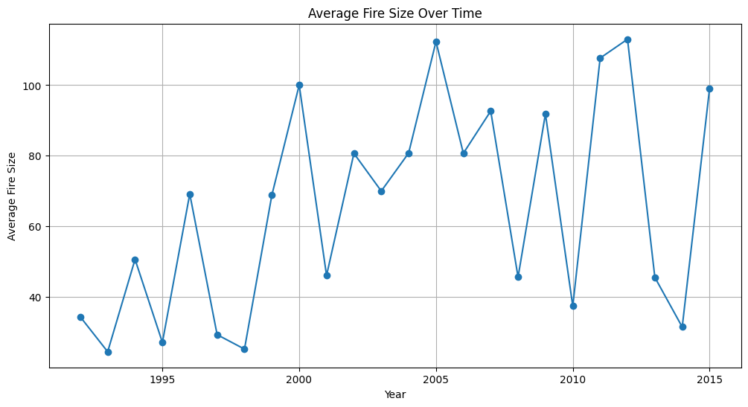
Frequency Analysis
We can see that the size of fires is rising
Notes:
For this graph we wanted to see the average fire size over the years

Slide 11
Models
We wanted to try and use the data to train a model that can predict, based on multiple fire parameters, what was the cause of the fire
We created 7 different models which have different number and combinations of layers and types, this resulted in a total of 28 models

Slide 12
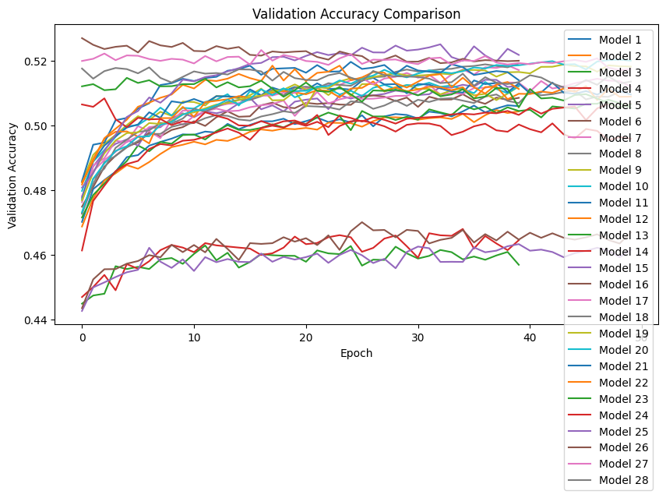
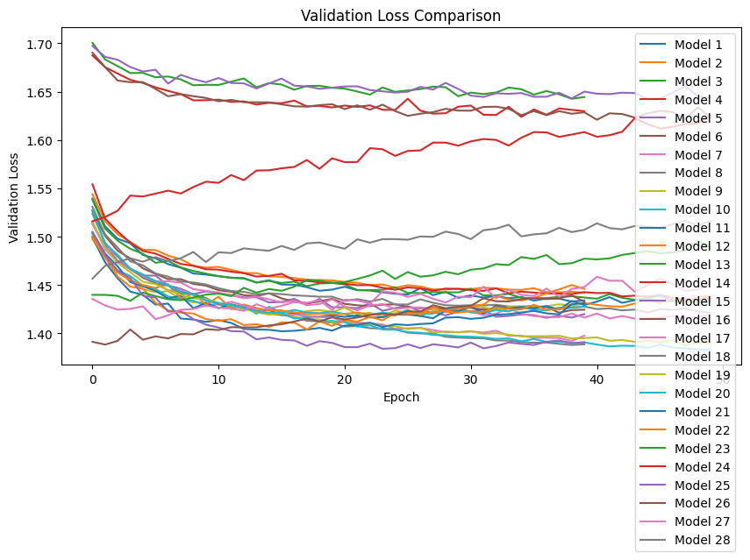
Hyperparameter Tuning
In order to receive the best possible model we ran each model in 4 different variations to find the best hyperparameters
We then compared all the models and picked and saw that the best three models were 26, 27, 25.
They had the highest average validation accuracy and lowest average validation loss

Slide 13
Model Results (Train)
 | Model 25 | Model 26 | Model 27
Average Validation Accuracy | 0.516 | 0.522 | 0.52
Average Validation Loss | 1.404 | 1.416 | 1.437
Combined Score | 0.01 | 0.013 | 0.012
Notes:
On the train and validation data the modeles scored:

Slide 14
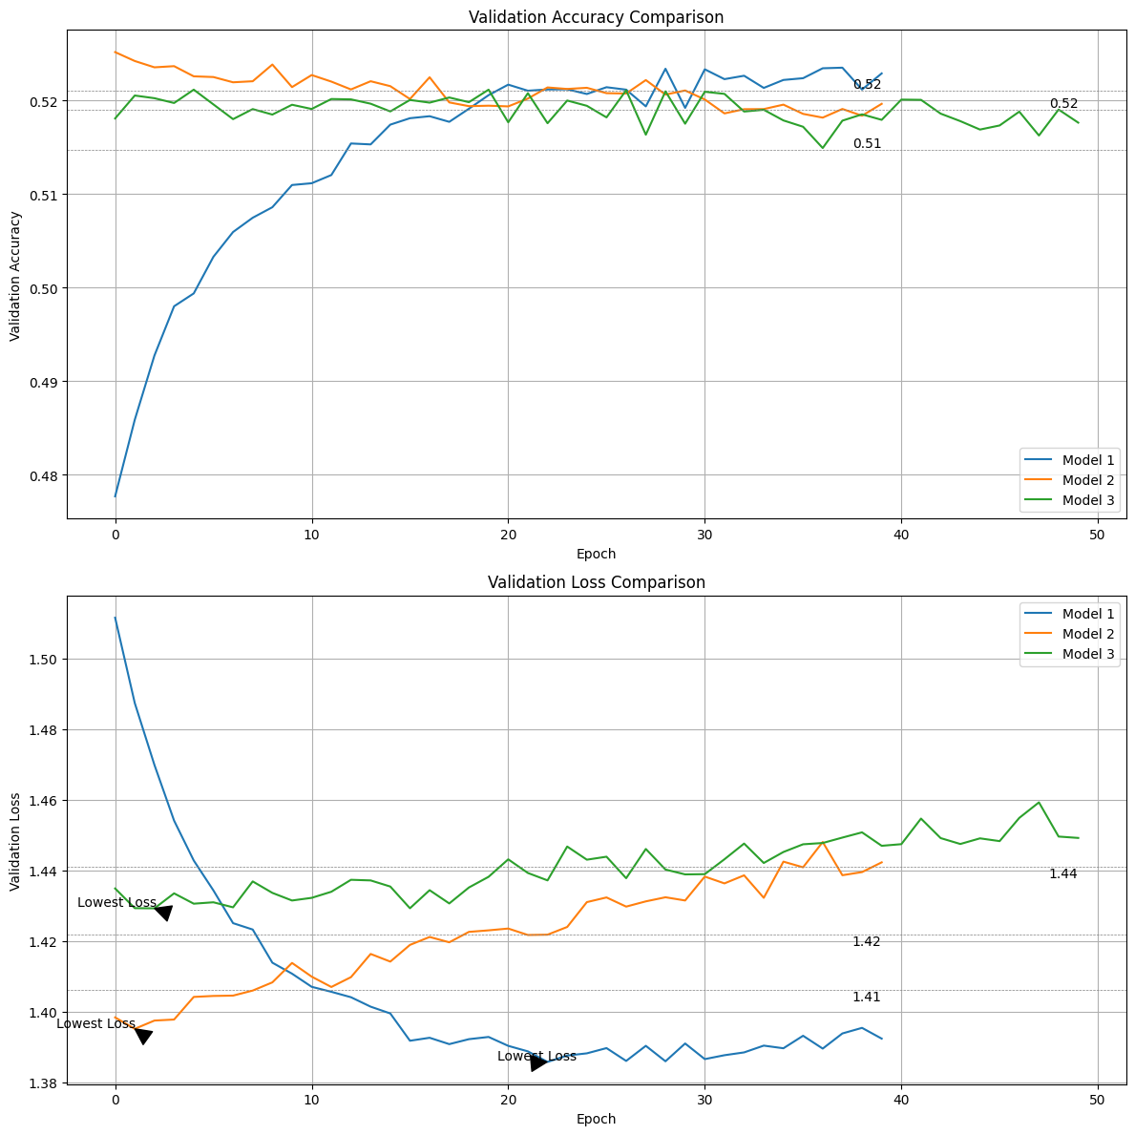
Model Results (Test)
Model 25 Test Loss: 1.406786 Test Accuracy: 0.518396
Model 26: Test Loss: 1.463799
Test Accuracy: 0.512569
Model 27: Test Loss: 1.475661
Test Accuracy: 0.507476
Notes:
We then ran the models on the test set and received the following results:

Slide 15
Production Ready
In order to use the model out of the box we have made our top model production ready
Download the zip file with the model pckl file and the script
Add your own data set with the matching types
Run the model

Slide 16
Conclusions
Using the data we gathered insurance companies can increase their profitability by:
Reducing costs of insurance claims using our model that can help detect the cause of a fire based on its parameters
Increased insurance priced based on location for states that have higher probability to have fires
Increase revenue by creating insurance coverage packages that include less probable causes for fires

Slide 17
Future Research
Our best model reached a maximal validation accuracy of 58% which is not enough to successfully predict the cause of the fire in consecutive runs, we believe the following steps could improve the models performance:
Our fire data is up until 2015 and more relevant data can assist with training the model and receiving higher results on today’s cases
Connecting an insurance company data set of fire damage claims can introduce new features which may highly impact our model performance
As we saw increasing the amount of layers and neurons helped the model achieve better results so a more sophisticated model might achieve better results

Slide 18
Thank You

